Slide 1
Arkansas
Thespian Festival 2023
Closing Ceremonies

Slide 2
In Shakespeare’s
Own Words
Billy Ivey

Slide 3
TECH TEAM EVENT
DESIGN AWARDS

Slide 4
TEAM COSTUME DESIGN CHALLENGE
7055 PULASKI ACADEMY

Slide 5
TEAM HAIR & MAKEUP DESIGN CHALLENGE
2123 LAKESIDE HIGH SCHOOL

Slide 6
TEAM SET DESIGN CHALLENGE
8707 North Little Rock
High School

Slide 7
THESPY SUPERIORS

Slide 8
COSTUME DESIGN
Pulaski Academy 7055 Madysen Nay
Mountain Home High School 6560 Trevi Sheaner
Greene County Tech 7614 Macey McLaughlin
Conway High School 9041 Emmalee Dillon
Bryant High School 8855 Amelia Johnson
Bentonville High School 3430 Abby Hastings
Bentonville High School 3430 Gabby Combes
North Little Rock High School 8707 Theodore Benson
Fayetteville High School 717 Sophie Moody
Cabot High School 2763 Leanna (Danielle) Rogers

Slide 9
COSTUME CONSTRUCTION
Fayetteville High School 717 Gigi Vawter
Pulaski Academy 7055 Emily McCarver
Parkview Arts/Science Magnet 7955 Zaryah Smith
Batesville High School 6564 Moriah Beyer

Slide 10
SCENIC DESIGN
Cabot High School 2763 Anna Kendall
Cabot High School 2763 Hannah Haskins
Pulaski Academy 7055 Louise Deltheil
Southside High School 2620 Joey Olsen

Slide 11
STAGE MANAGEMENT
Lakeside High School 2123 Elli Uldrich
Conway High School 9041 Emma Cariker
Van Buren High School 7448 Katelyn Foster
Russellville HIgh School 7620 Silvina Garcia
Alma High School 6338 Abbi Hayden

Slide 12
MAKEUP DESIGN
Beebe High School 4827 Taiyah Tims

Slide 13
PLAYWRITING
Pulaski Academy 7055 Madysen Nay

Slide 14
SHORT FILM
Cabot High School Troupe 2763
Alma High School Troupe 6338
Southside High School Troupe 2620
Mountain Home High School Troupe 6560
Bentonville High School Troupe 3430

Slide 15
SOLO ACTING
Mount St. Mary Academy 8462 Anna Mammarelli
Parkview Arts/Science Magnet High School 7955 Marionna Parker
Beebe High School 4827 Katie Young
North Little Rock High School 8707 Jerzey Banks
Parkview Arts/Science Magnet High School 7955 Camille Gardner
Lakeside High School 2123 Natalie Shunk
Lakeside High School 2123 Katie Brown

Slide 16
SOLO ACTING
Lakeside High School 2123 Penny Fuller-Freeman
Trumann High School 7813 Autumn New
Alma High School 6338 Denver Kelly
Fayetteville High School 717 Nick Guthrie
Fayetteville High School 717 Camille Purkey
Cabot High School 2763 Sofia Albertin
Gravette Senior High School 5262 Audrey Houghton

Slide 17
SOLO ACTING
Conway High School 9041 Penny Derden
Brookland High School 8299 Aron Davis
Greene County Tech 7614 Aubree Crum
Conway High School 9041 Nhi Webster
Arkansas Arts Academy 7414 Zachary Phillips
Brookland High School 8299 Mia Stacey
Brookland High School 8299 Lila Boles

Slide 18
SOLO ACTING
Brookland High School 8299 Kiersten Dalton
Gravette Senior High School 5262 Ethan Strecker
Harding Academy 6192 Anna Mulvany
Batesville High School 6564 Sophia Bridgers
Gravette Senior High School 5262 Kanisha Villarreal
Gravette Senior High School 5262 Skylar Hernandez

Slide 19
DUET ACTING
Lakeside 2123 Cade Espinoza & Nicole Smith
Cabot 2763 Madelyn Stiles & Abigail Lane

Slide 20
GROUP ACTING
Fayetteville High School Troupe 717
Alma High School Troupe 6338

Slide 21
SOLO MUSICAL DANCE
Cabot High School 2763 Jersey Grace Petross
Cabot High School 2763 Mia Crafton
Cabot High School 2763 Ashley Drees
Alma High School 6338 Katie Major
North Little Rock High School 8707 Kikiya Smith
Mountain Home High School 6560 Kylie Andrews
Little Rock Central High School 6418 Madison Tucker
Bryant High School 8855 Laiken Clarke
Russellville High School 7260 Libby Willis
Alma High School 6338 Brenna Morris
Mountain Home High School 6560 Mia Williams
Hot Springs World Class High 78 Jariah Selman

Slide 22
DUET MUSICAL DANCE
Harding Academy 6192 Abigail Fox & Hannah Campbell

Slide 23
GROUP MUSICAL DANCE
Cabot High School Troupe 2763

Slide 24
SOLO MUSICAL
Parkers Chapel High School 8889 Clayton Evers
Parkers Chapel High School 8889 Hannah Hickman
Hot Springs World Class High School 78 Danielle Rivera
Russellville High School 7260 Emma Jernigan
Russellville High School 7260 Sadie Hilton
Clarksville High School 6789 Graceanne Morgan
Cabot High School 2763 Piper Selah
Cabot High School 2763 Reagan Whitledge
Lakeside High School 2123 Brennan Wilkins
Lakeside High School 2123 Christina Myers
Lakeside High School 2123 Jenna Thaxton
Lakeside High School 2123 Kenleigh Garner

Slide 25
SOLO MUSICAL
Cabot High School 2763 Mia Lendermon
Conway High School 9041 Aiden Eslinger
Trumann High School 7813 Eddie LaRay Watson
Alma High School 6338 Morgan English
Alma High School 6338 Maddie Cochran
Alma High School 6338 Talon Dean
Alma High School 6338 Mick Clawson
Alma High School 6338 Isabella Chapen
Russellville High School 7260 Isabelle Clements
Har-Ber High School 7262 Gracie Kennett
Russellville High School 7260 Tess Barborek
Har-Ber High School 7262 Phoebe Harris

Slide 26
SOLO MUSICAL
Little Rock Central High School 6418 Elizabeth Tull
Little Rock Central High School 6418 Ruby Reeves
Fayetteville High School 717 Olive Zweig
Fayetteville High School 717 Peyton Lions
Fayetteville High School 717 Victor Blasingame
Cabot High School 2763 Lindy McLeod
Pulaski Academy 7055 Annabelle Redenius
Pulaski Academy 7055 Caroline Perry
Community School of the Arts 10124 Elizabeth Marine
Mountain Home High School 6560 Cayden Sabella
Cabot High School 2763 Alle Parker
Russellville High School 7260 Sydney Jones

Slide 27
SOLO MUSICAL
Bentonville High School 3430 Stevie St. John
Little Rock Christian Academy 8226 Allison Hatfield
North Little Rock High School 8707 Emily Bell
Conway High School 9041 Ava Weeks
Jacksonville High School 10111 Tristyn Armstrong
Mount St. Mary Academy 8462 Maya Henry
Mount St. Mary Academy 8462 Isbella Nguyen
Mount St. Mary Academy 8462 Lizzy Darnold
Mount St. Mary Academy 8462 Maya Johnson
Pulaski Academy 7055 Caroline Pledger
Mountain Home High School 6560 Sierra Trogdon
Conway High School 9041 Lucy Strahin

Slide 28
SOLO MUSICAL
Greene County Tech 7614 Ella Murray
Beebe High School 4827 Nataleigh Lindsey
Jonesboro High School 1338 Khia Jones
Siloam Springs High School 7982 Kate Kelley
Greenbrier High School 8942 Riley Bart
Greenbrier High School 8942 Lauren Rowe
Bentonville High School 3430 Ian Sonnabend
Van Buren High School 7448 Faith Cureton
Greene County Tech 7614 Gracey Worthington
Brookland High School 8299 Cannon Smith
Van Buren High School 7448 Hadley Gilmore
Batesville High School 6564 Derek Medina

Slide 29
SOLO MUSICAL
Batesville High School 6564 Emily Wade
Southside Senior High School 2620 Lilly Bottoms
Hot Springs World Class High School 78 Mya Sanders
Bentonville West High School 8538 Eleni Konomi
Bentonville West High School 8538 Mayuko "Uko" Van Duzee
Bentonville West High School 8538 Meredith Spence
Southside High School 2620 Josephine Clamser
Southside High School 2620 Ellie Caruthers

Slide 30
SOLO MUSICAL
Bentonville High School 3430 Alyssa Hodde
Arkansas Arts Academy 7414 Elisabeth Miller
Benton High School 5779 Isabella Crabb
Gravette High School 5262 Olivia Fordham
Benton High School 5779 Ariel Bronson
Benton High School 5779 Micah Hall
Benton High School 5779 Kaylen Hughes

Slide 31
DUET MUSICAL
Pulaski Academy 7055 Addison Peirce & Luci Hudson
Little Rock Central High School 6418 Barlow Brenner & Ernest Quirk
Cabot High School 2763 Grayson Lee & Jake Johnson
Harding AcademY 6192 Isabel Hoggard & Brody Smith
Conway High School 9041 Nate Westerman & Mary Caroline Grimes
Little Rock Christian Academy 8226 Alyssa White & Veronica Ivester
Gentry High School 8897 Mallory Rogers & Diego Reynoso
Bentonville High School 3430 Whitney Webb & Miles Ortiz
Gentry High School 8897 Daniel Carrera & Johan Lee

Slide 32
GROUP MUSICAL
Cabot High School Troupe 2763
Bryant High School Troupe 8855
Mount St. Mary Academy Troupe 8462
Lakeside High School Troupe 2123
Alma High School Troupe 6338
Pulaski Academy Troupe 7055

Slide 33
GROUP MUSICAL
Mountain Home High School Troupe 6560
Van Buren High School Troupe 7448
Hot Springs World Class High School Troupe 78
Russellville High School Troupe 7260
Southside Senior High School Troupe 2620
Har-Ber High School Troupe 7262

Slide 34
MINUTE TO GIVE IT GRAND TOTAL

Slide 35
$1,058.66

Slide 36
SCHOLARSHIPS

Slide 37
$1,154,410.00

Slide 38
MICHELLE MOSS
THEATRE FOR LIFE SCHOLARSHIP
BROOKLYN COURTNEY-MOORE

Slide 39
LISA AREY AR EDTA PERFORMANCE SCHOLARSHIP
VICTOR BLASINGAME

Slide 40
MARSHA WOOLEY AR EDTA THEATRE EDUCATION SCHOLARSHIP
SADIE HILTON

Slide 41
DOUGLAS GILPIN
TECHNICAL THEATRE SCHOLARSHIP
MADYSEN NAY

Slide 42
AR EDTA PERFORMANCE SCHOLARSHIP
CAROLINE PERRY

Slide 43
AR EDTA PERFORMANCE SCHOLARSHIP
MYA SANDERS

Slide 44
AR EDTA PERFORMANCE SCHOLARSHIP
CADEN SABELLA

Slide 45
AR EDTA PERFORMANCE SCHOLARSHIP
PEYTON LYONS

Slide 46
AR EDTA
FILM SCHOLARSHIP
IAN SONNABEND

Slide 47
NANCY BROWN STO LEADERSHIP SCHOLARSHIP
Natalie Shunk Troupe 2123

Slide 48
NANCY BROWN STO LEADERSHIP SCHOLARSHIP
Audrey Stahl Troupe 7260

Slide 49
NANCY BROWN STO LEADERSHIP SCHOLARSHIP
Graceann Morgan Troupe 6789

Slide 50
GAIL BURNS THEATRE EDUCATOR
OF THE YEAR

Slide 51
JENAVA HARRIS
CLARKSVILLE HIGH SCHOOL

Slide 52
RICK CHUDOMELKA
CRITIC’S CHOICE AWARD
CHAPTER SELECT

Slide 53
HALL OF
FAME AWARD

Slide 54
HOLLIE SHEPHERD

Slide 55
SPECIAL RECOGNITION

Slide 56
DAWN TUCKER
17 YEARS OF EXTRAORDINARY SERVICE

Slide 57
AND YOUR NEW
STO’S ARE…

Slide 58
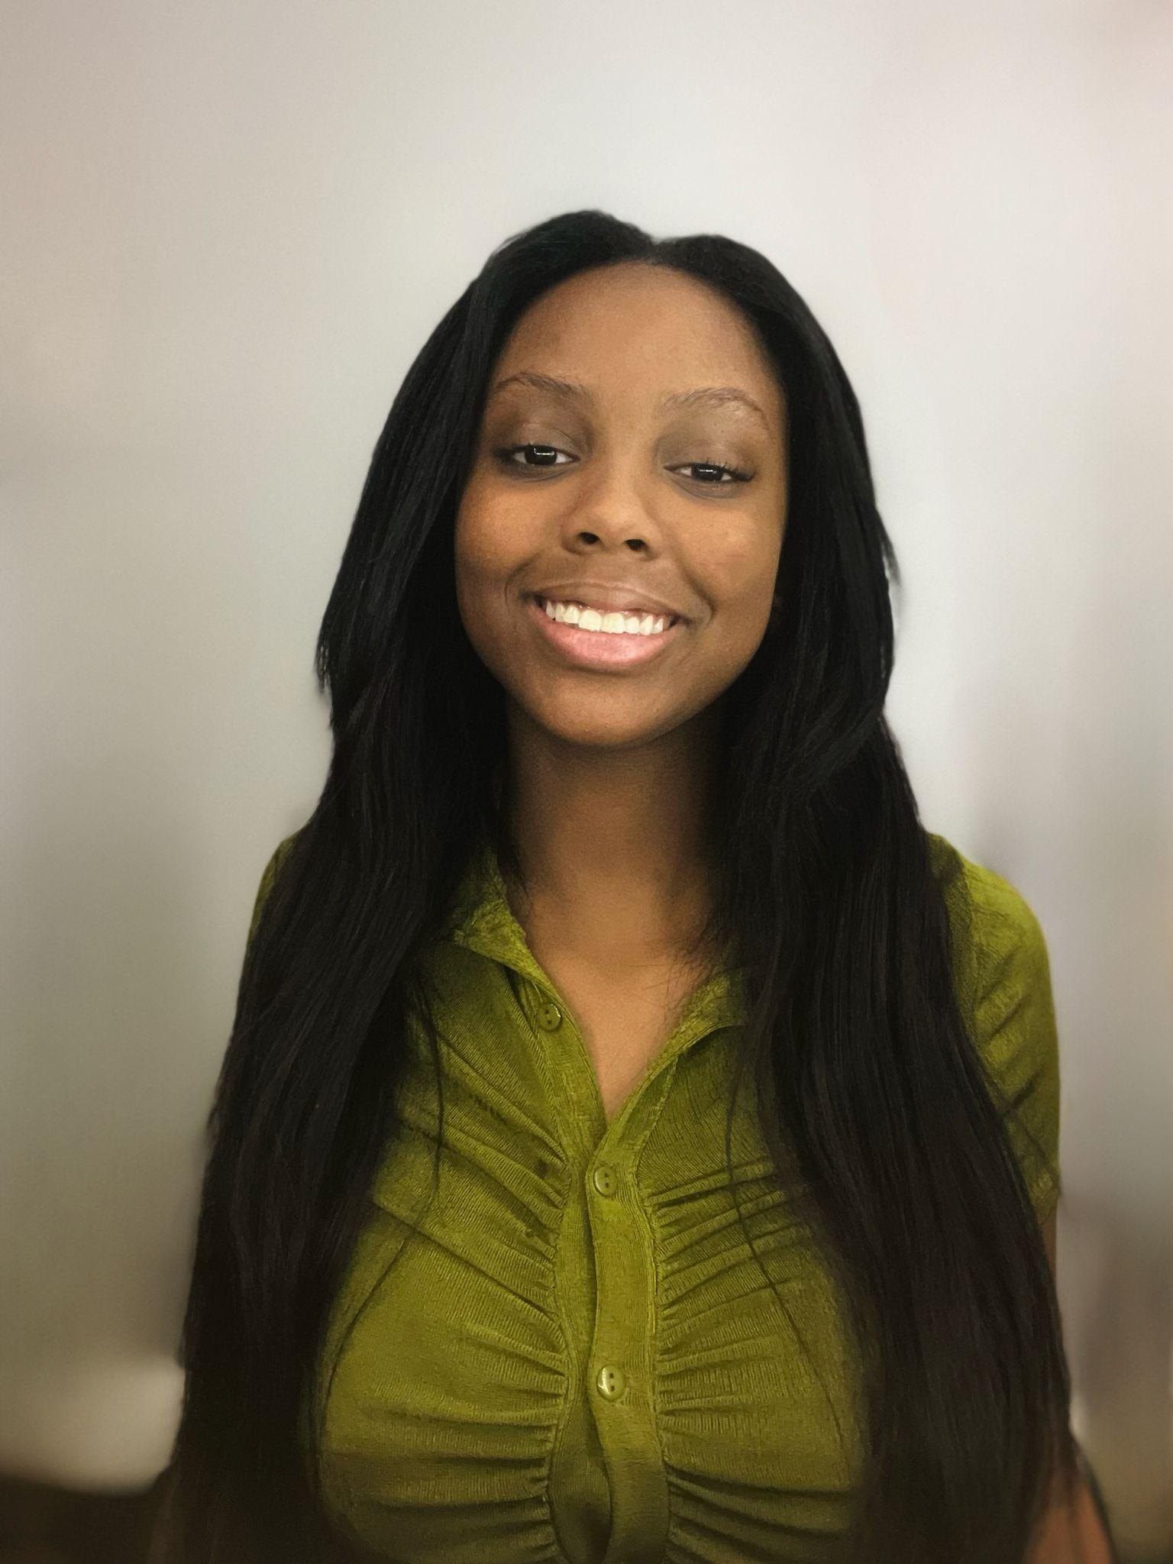
Alise Whitfiled
Troupe 717

Slide 59
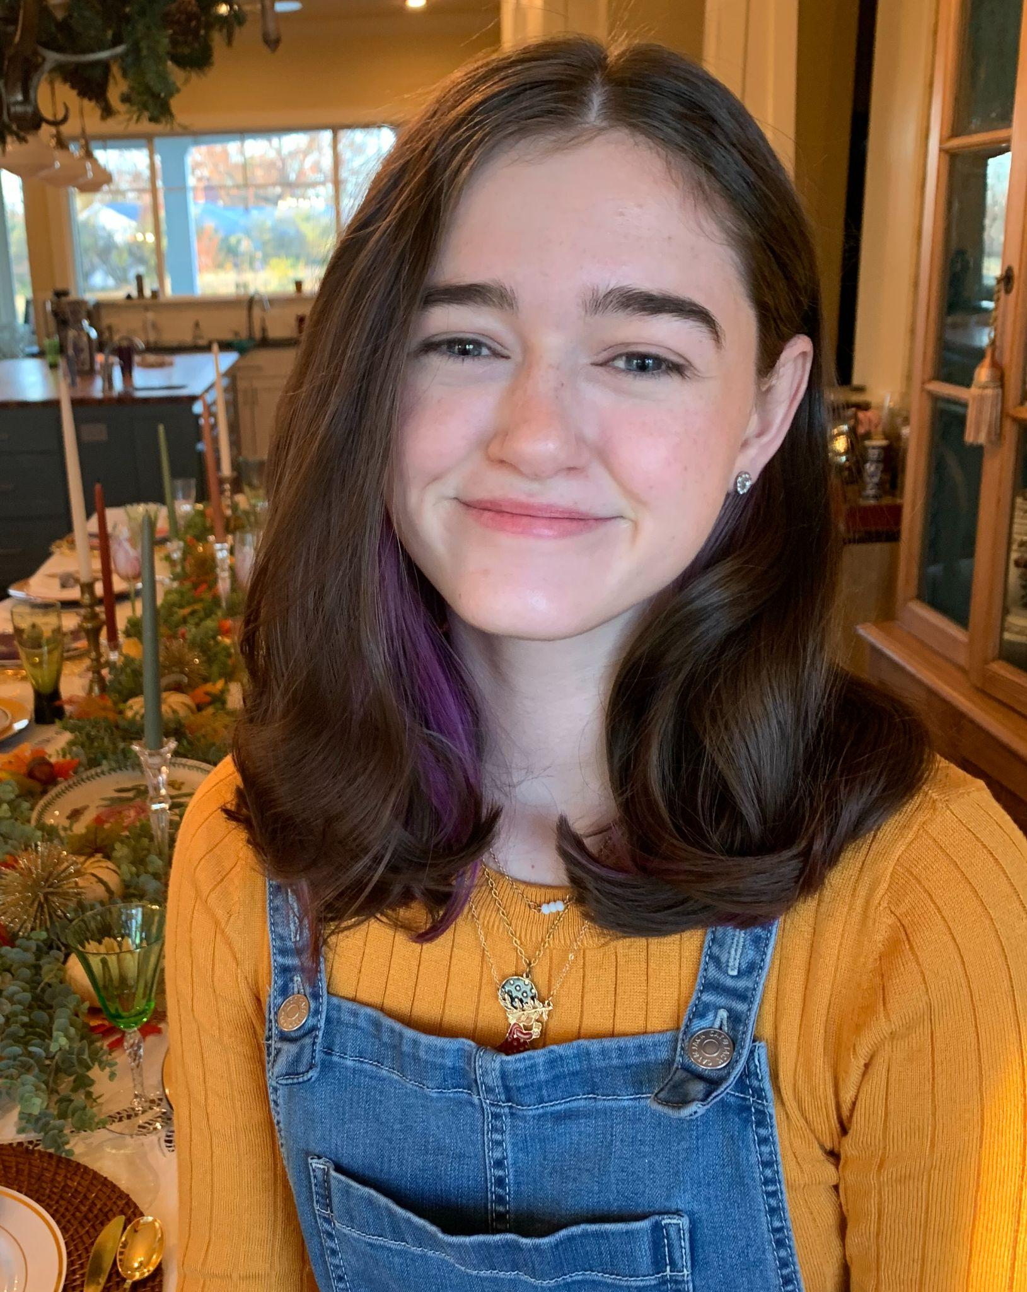
Ginny Ziegler
Troupe 2620

Slide 60
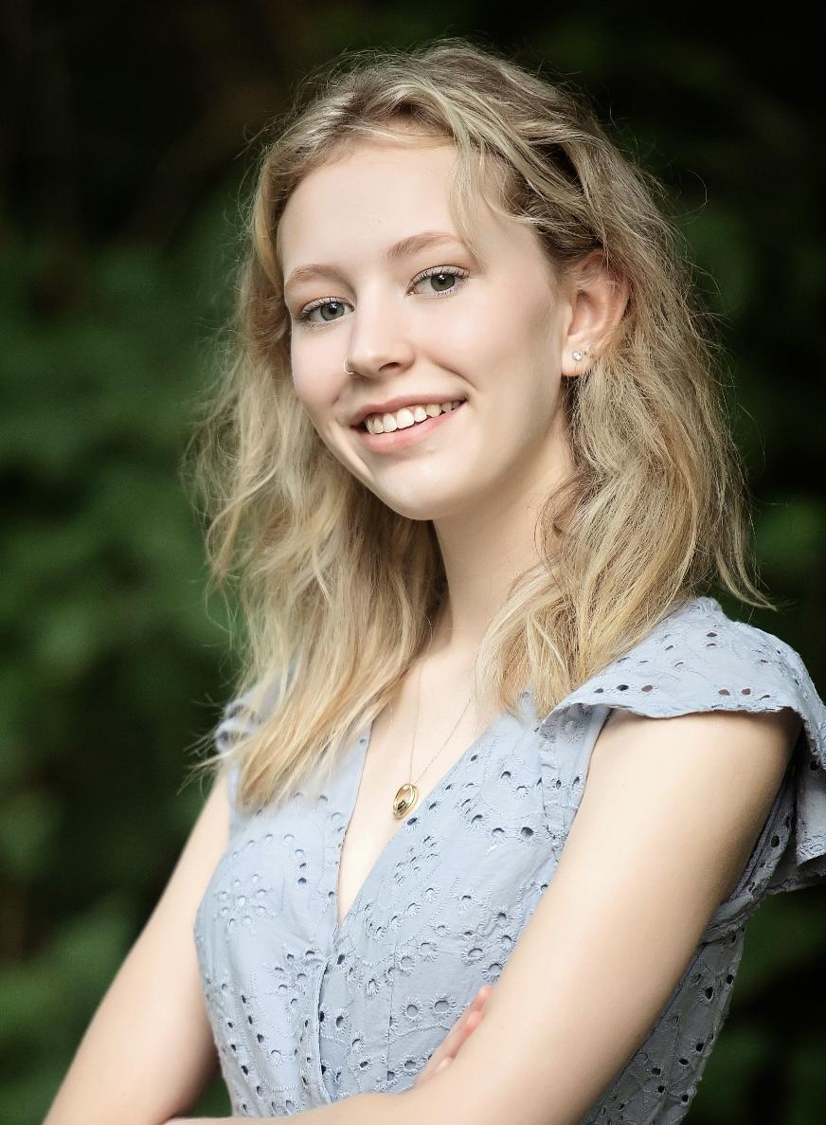
Katie Brown
Troupe 2123

Slide 61
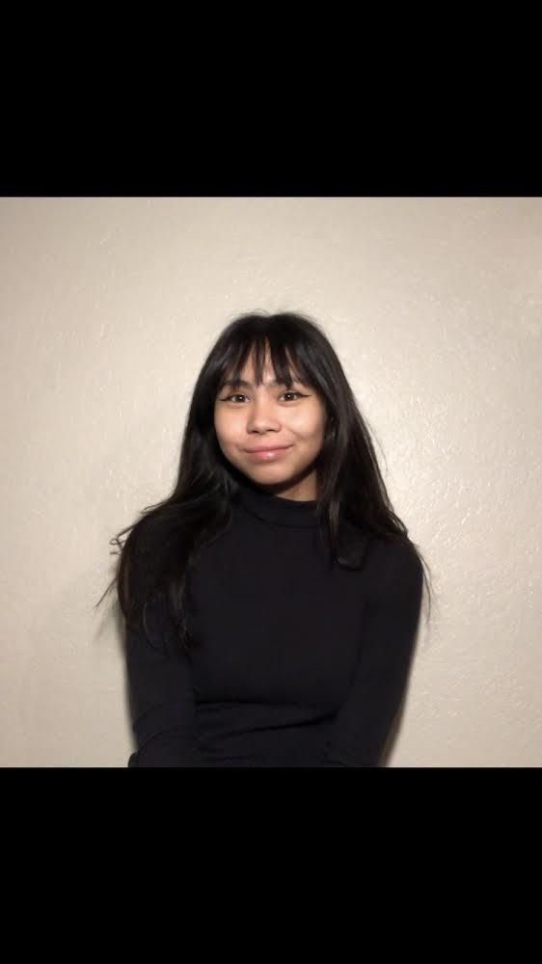
Maggie Martin
Troupe 340

Slide 62
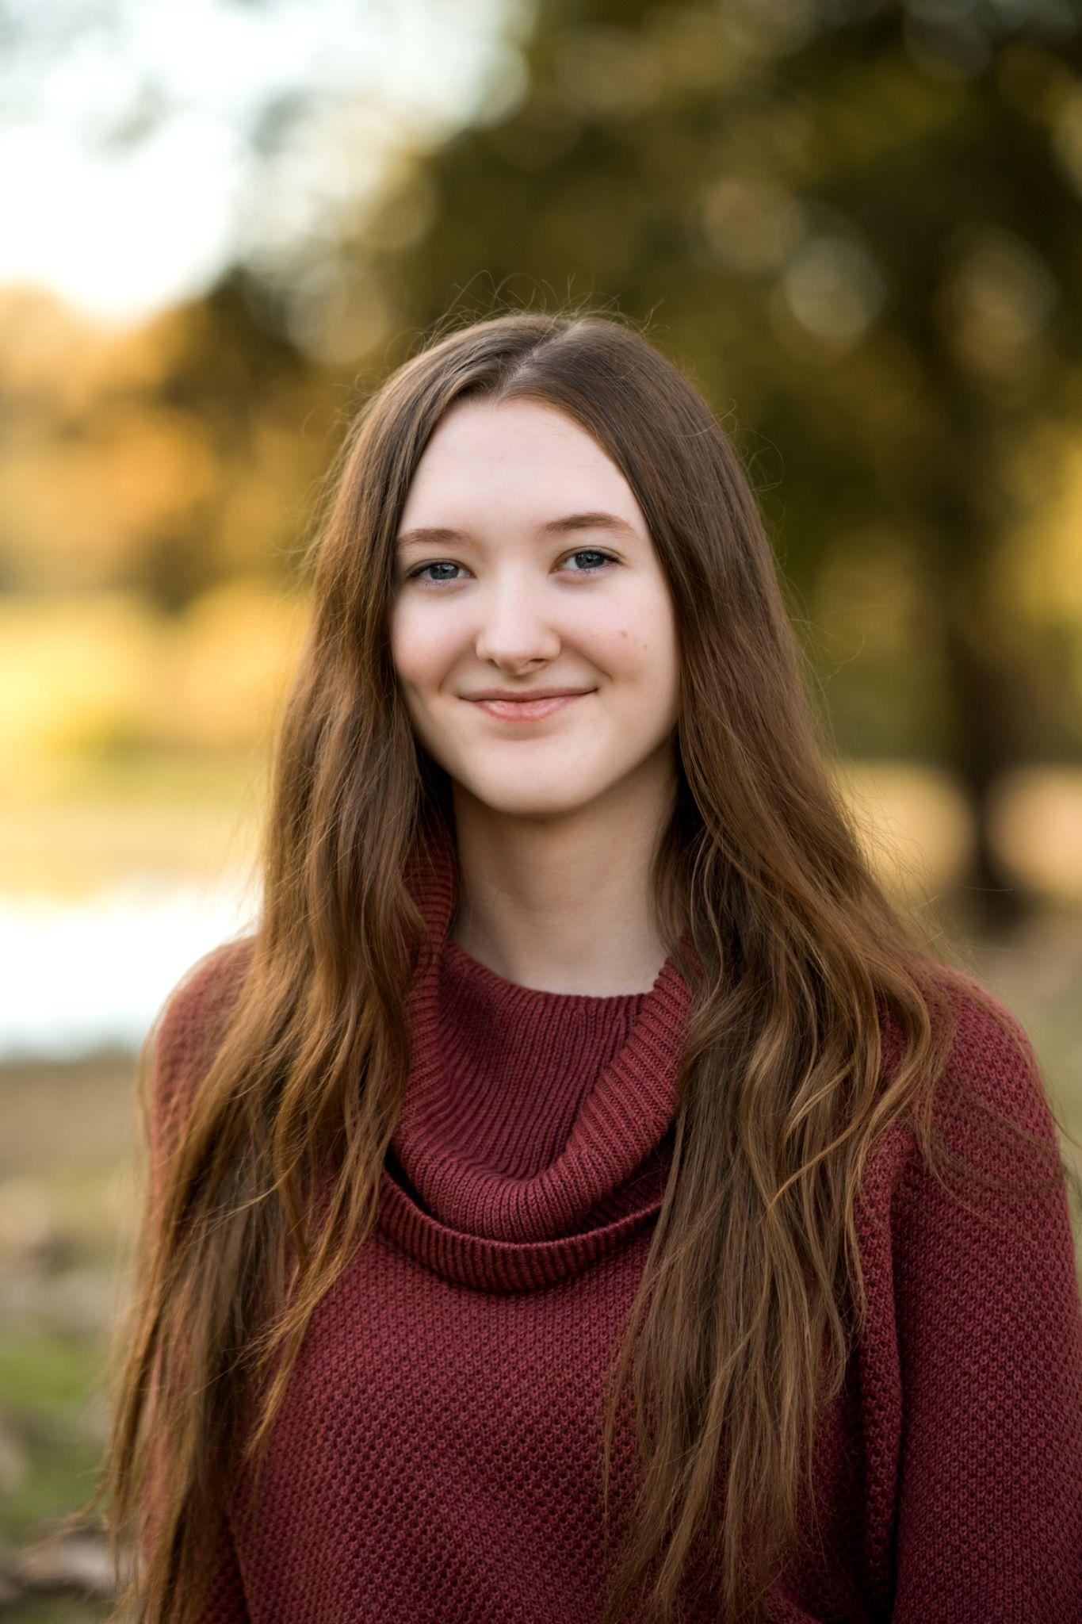
Sarah Goodman
Troupe 10124

Slide 63
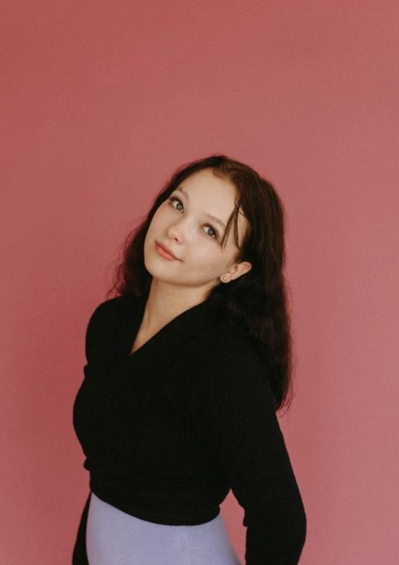
Taylor Buckholtz
Troupe 7260

Slide 64
Arkansas
Thespian Festival 2023

Slide 65
ANNOUNCEMENTS

Slide 66
Arkansas
Thespian Festival 2023

